Slide 1

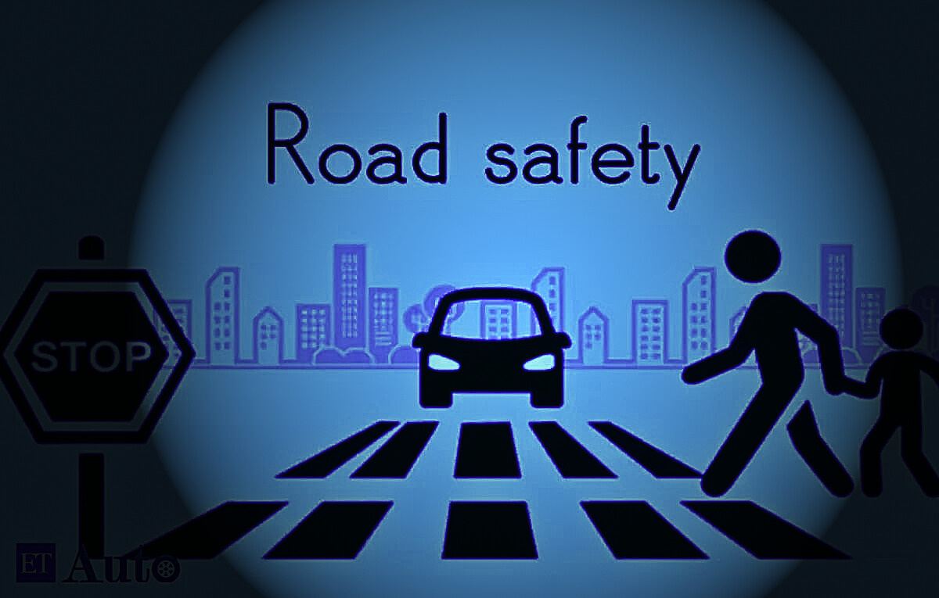
ACCIDENT
PREDICTION
AND
PREVENTION
Presented by: Team lrvijay2003

Slide 2
OVERVIEW
01
02
03
04
05
Summary
Map
Proposed solutions
Real-time Accident Detection
Driver behavior analysis
04
05
06
06
06
Road condition monitoring
Intelligent traffic management
Collision prevention system
Crash data analysis
System Architecture

Slide 3
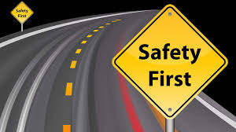
SUMMARY
We introduce a comprehensive AI-driven solution for accident prevention and prediction in the realm of transportation safety. Our solution leverages advanced machine learning algorithms and AI tools to enhance real-time accident detection, analyze driver behavior, monitor road conditions, optimize traffic management, prevent collisions, and improve crash data analysis. The combination of these features aims to significantly enhance road safety and contribute to the overall efficiency of transportation systems.

Slide 4
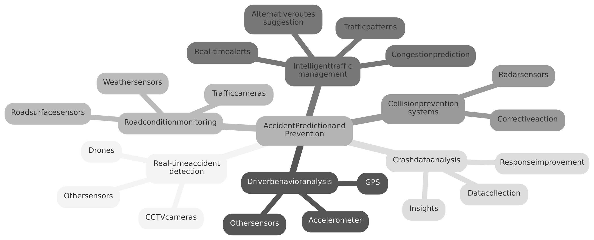
MAP

Slide 5

SOLUTIONS
Real-time Accident Detection
Driver Behavior Analysis
Road Condition Monitoring
Intelligent Traffic Management
Collision Prevention Systems
Crash Data Analysis

Slide 6

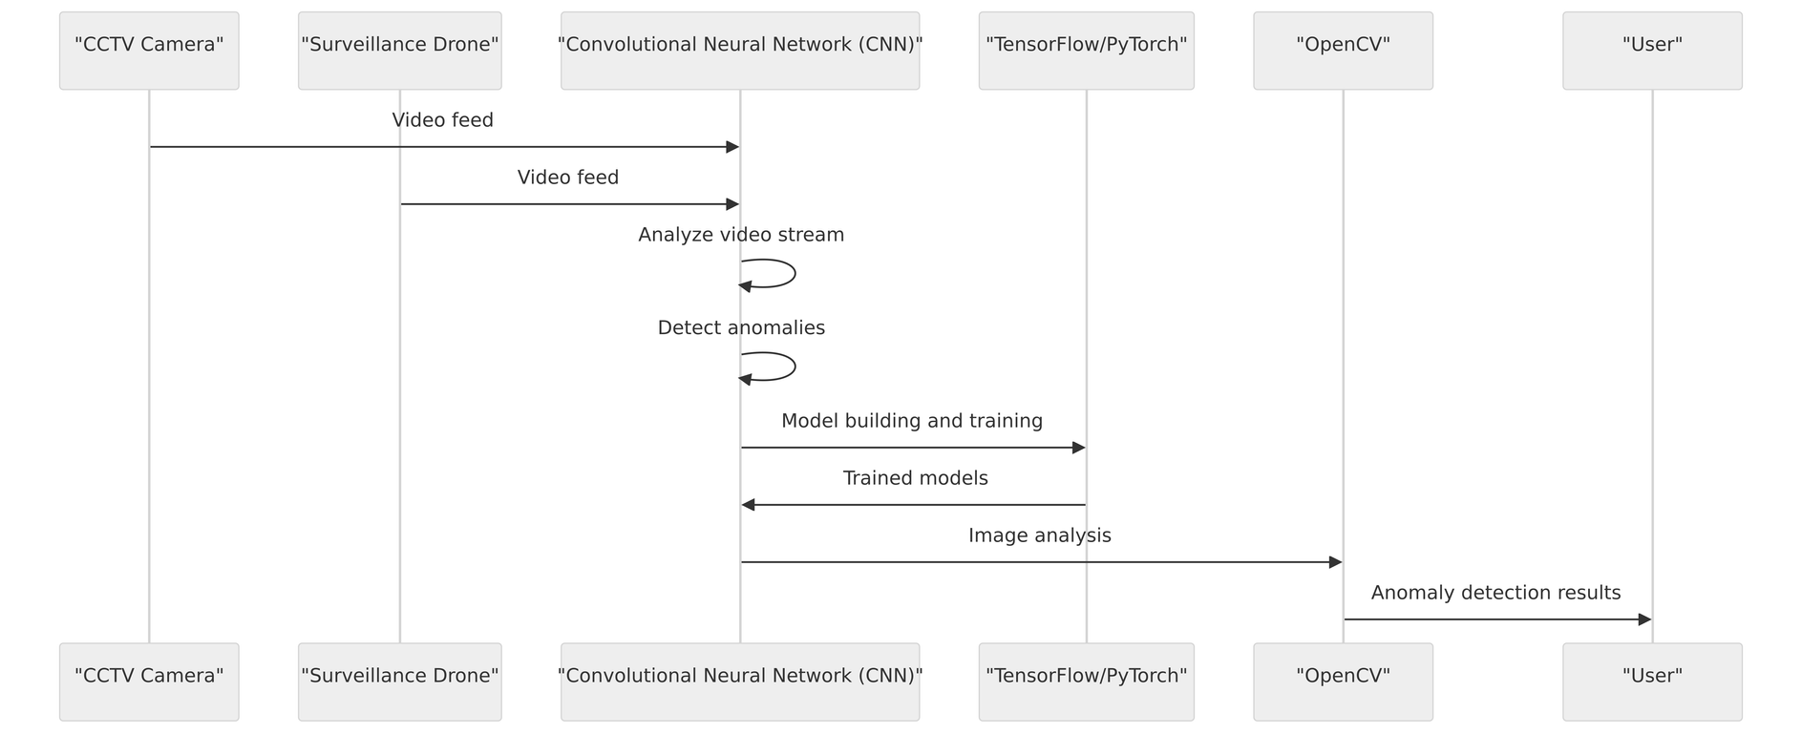
Real-time Accident Detection
1. Input Source:
Real-time Accident Detection begins with the input of video feeds sourced from CCTV cameras or drones, providing a continuous stream of visual information.
2. Preprocessing Steps:
Frames from the video feed undergo preprocessing, involving extraction and processing through a Convolutional Neural Network (CNN). This step prepares the data for further analysis.
3. Detection Process:
The CNN, with its specific architecture, layers, and filters, analyzes the frames to identify anomalies. It focuses on sudden changes in speed, direction, or trajectory within the visual data.
4. Output Generation:
Based on the analysis, the system generates real-time alerts or notifications. These alerts serve as proactive measures to notify relevant parties about potential accidents, allowing for timely responses.
5.Algorithm Refinement:
The effectiveness of the detection system is enhanced through the refinement of the CNN algorithm. This involves training the model with annotated accident and non-accident frames, and fine-tuning hyperparameters to optimize detection accuracy.
6. Tools Utilized:
TensorFlow or PyTorch are employed for building and training the CNN, providing a robust framework for machine learning tasks.
OpenCV plays a crucial role in preprocessing and computer vision tasks, contributing to the efficiency of the real-time accident detection system.

Slide 7
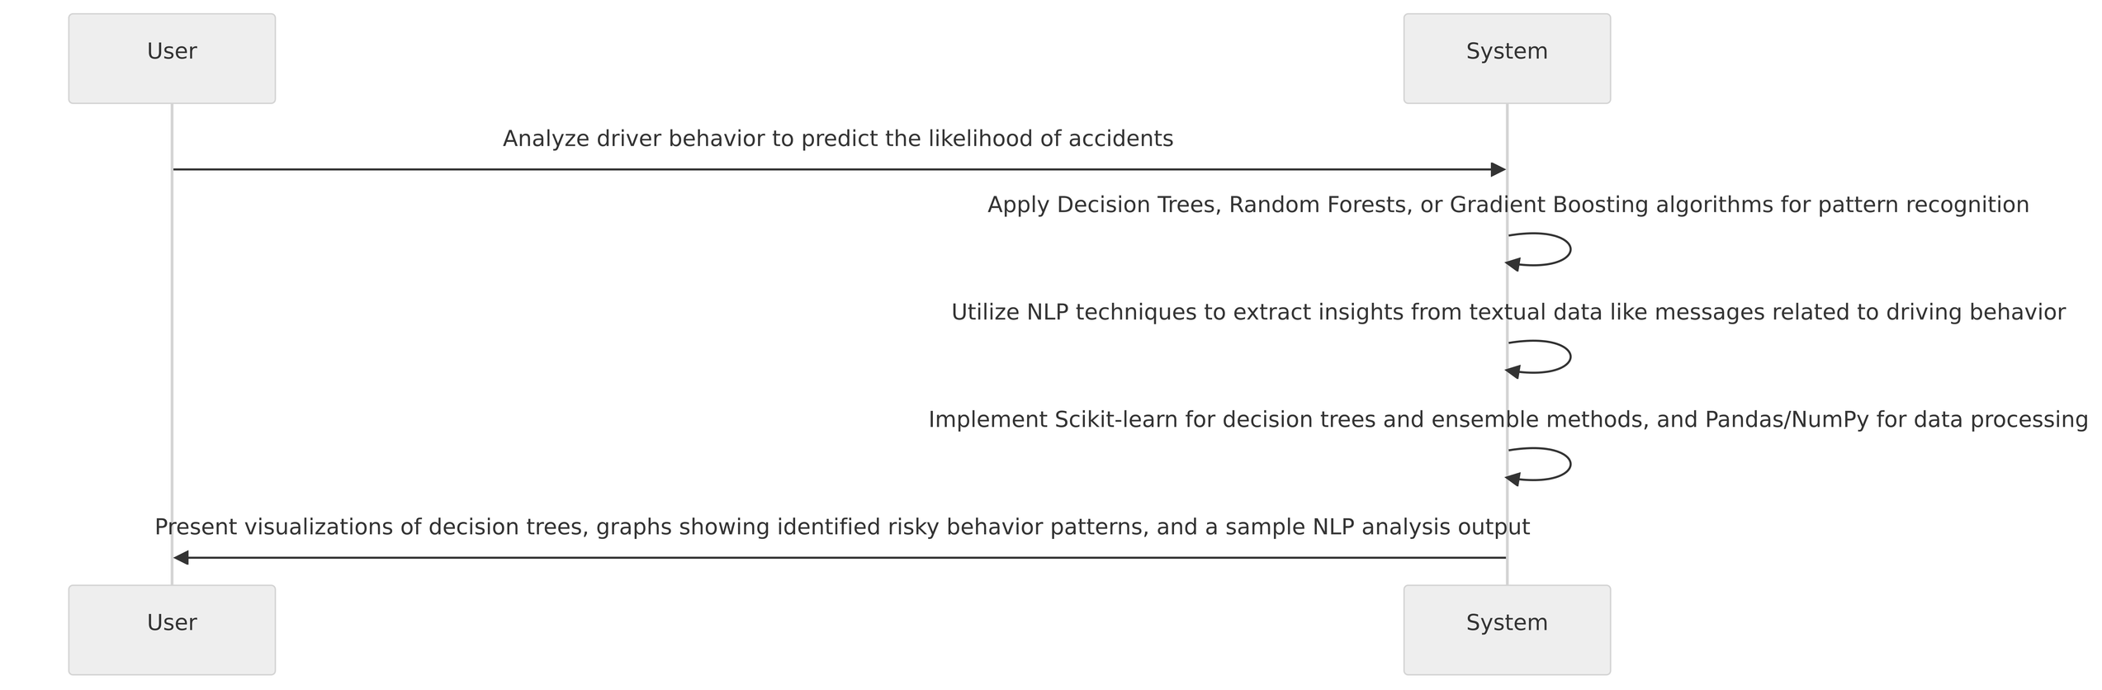
Driver Behaviour Analysis
1. Data Sources: The system begins by taking input data from various sensors, including GPS, accelerometers, and other relevant sources, to capture a comprehensive view of the driver's behavior.
2. Algorithmic Analysis: Decision Trees or Random Forests are applied to the input data, leveraging these algorithms to identify and analyze patterns in driving behavior. These algorithms excel in capturing complex relationships within the dataset.
3. Outcome Prediction:The result of the analysis is predictions regarding the likelihood of risky behavior that could lead to accidents. These predictions serve as early warnings for potential safety concerns.
4. Decision Tree Structures: The decision-making process involves the creation of decision tree structures, outlining the sequential steps that the algorithm takes to arrive at a prediction. These structures provide transparency into the decision-making process.
5. Feature Importance: Within the analysis, the system determines the importance of different features in influencing predictions. This insight helps in understanding which aspects of driver behavior contribute most significantly to the risk assessment.
6. Textual Data Processing:To enhance the analysis, the system incorporates Natural Language Processing (NLP) techniques for processing textual data associated with driving behavior. This could include messages or notes related to the driving patterns, providing a richer context for analysis.

Slide 8
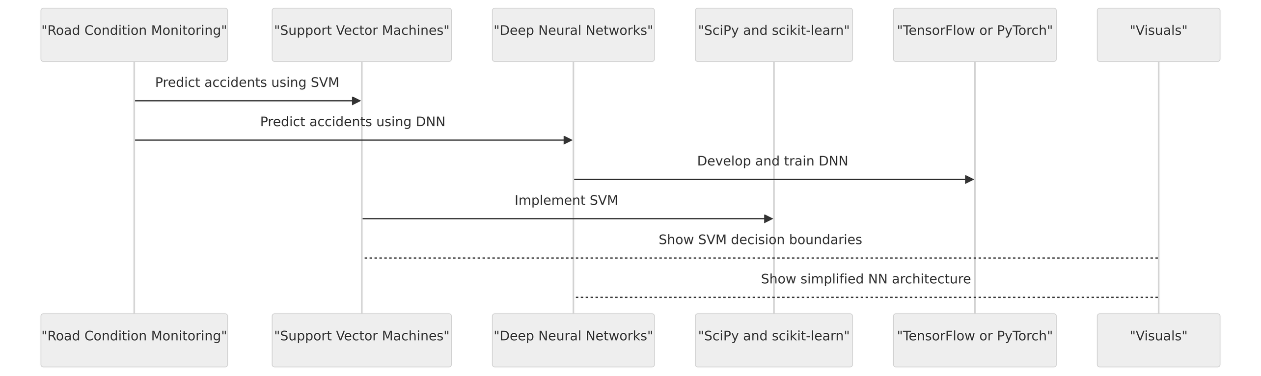
Road Condition Monitoring
1. Data Integration: The system begins by gathering data from diverse sources, including weather sensors, traffic cameras, and road surface sensors, creating a comprehensive dataset reflecting various aspects of road conditions.
2. Predictive Analysis: Utilizing either Support Vector Machines (SVM) or Deep Neural Networks, the system conducts predictive analysis to assess the likelihood of accidents based on the input data. This analysis is crucial for proactively identifying potential hazards.
3. Outcome Generation: The output of the analysis is a set of predictions that provide insights into road conditions. These predictions help in understanding and addressing factors that might contribute to unsafe driving conditions.
4. Decision Boundaries (SVM): In the case of SVM, decision boundaries are established to define regions within the feature space. These boundaries play a key role in determining the separation between different classes, aiding in the prediction of accident likelihood.
5. Neural Network Architectures: For systems employing Deep Neural Networks, the architectures of these networks are crafted to efficiently process and extract meaningful patterns from the complex input data, contributing to accurate predictions.
6. Optimization Through Hyperparameter Tuning: To enhance the model's performance, hyperparameters are tuned. This involves adjusting parameters such as learning rates or regularization strengths, optimizing the model for accuracy and efficiency.

Slide 9
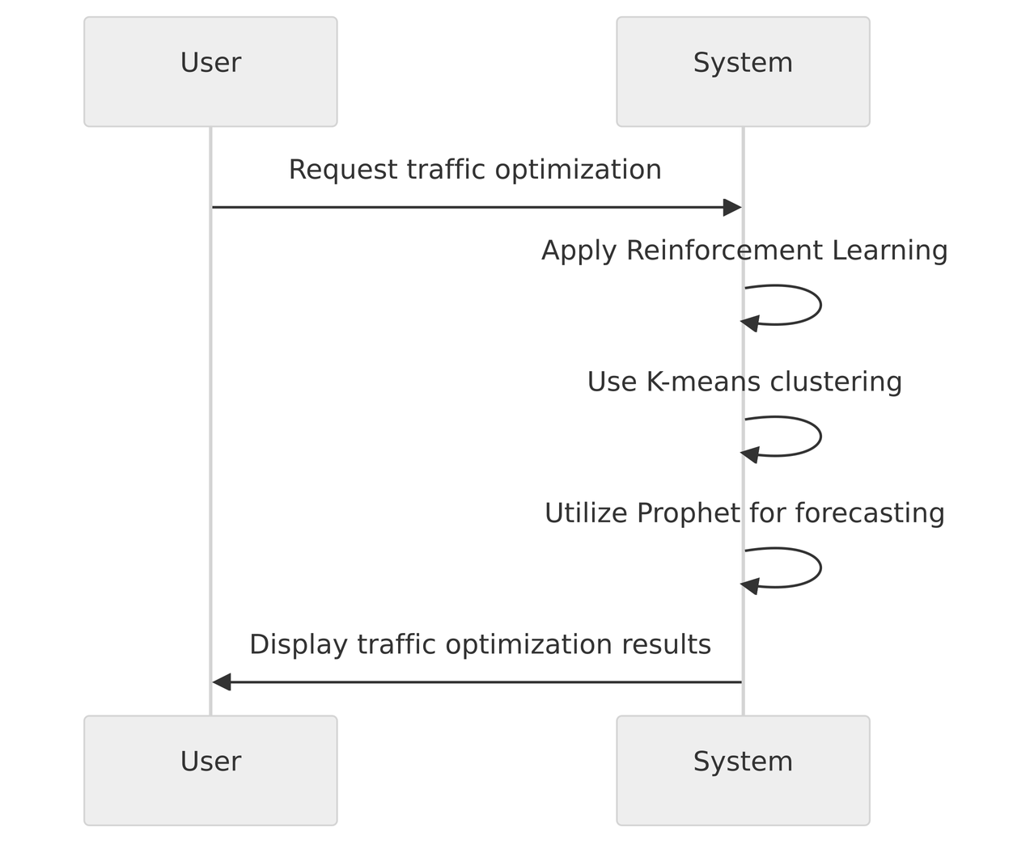
Intelligent Traffic Management
1. Real-time Traffic Data Integration: The system begins by collecting real-time traffic data, including information on current traffic conditions, congestion levels, and other relevant factors, serving as the input for the intelligent traffic management system.
2. Reinforcement Learning for Optimization: Leveraging reinforcement learning algorithms, particularly Q-learning, the system optimizes traffic flow by learning from the dynamic traffic environment. This approach allows the system to make informed decisions to improve overall traffic efficiency.
3. Clustering for Pattern Identification: Clustering algorithms, such as K-means, are applied to identify patterns within the traffic data. This step aids in understanding the distribution of traffic, detecting congestion areas, and determining alternative routes.
4. Traffic Flow Optimization Suggestions:Based on the insights gained from reinforcement learning and clustering, the system generates suggestions for optimizing traffic flow. These suggestions may include adjustments to signal timings, lane allocations, or routing instructions.
5.Alternative Routes Identification: The system utilizes the clustering results to identify alternative routes for drivers. This proactive approach helps in minimizing congestion and providing drivers with options to avoid potential traffic obstacles.
6. Adaptive Learning Through Reinforcement: The reinforcement learning component continuously adapts to changing traffic conditions, learning from its interactions with the environment. This adaptive learning process ensures that the system remains effective in dynamic traffic scenarios.

Slide 10
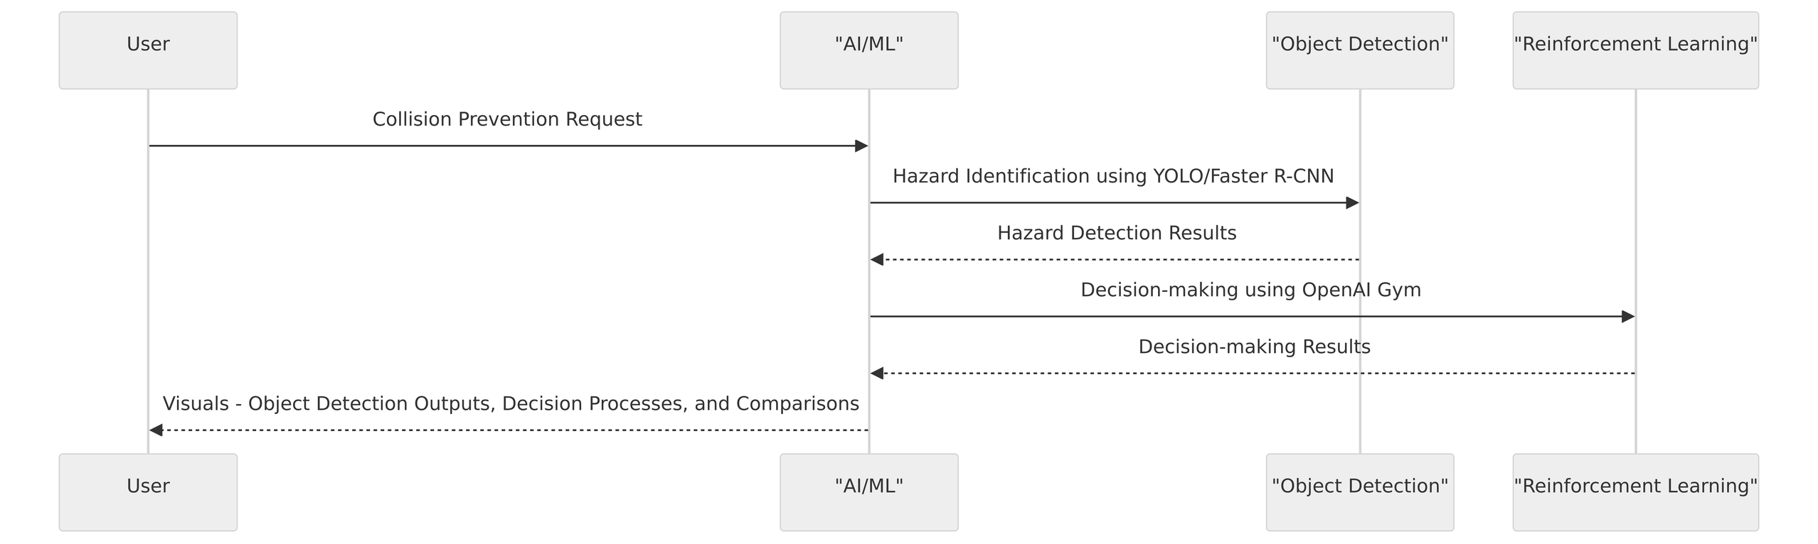
Collision Prevention Systems
1. Input Data Sources: The collision prevention system starts by acquiring data from cameras and radar sensors, enabling a comprehensive understanding of the surrounding environment.
2. Hazard Identification: YOLO (You Only Look Once) or Faster R-CNN (Region-based Convolutional Neural Network) architectures are employed for efficient and accurate detection of potential hazards within the input data.
3. Decision-Making Process:After hazard identification, the system engages in a decision-making process. This involves reinforcement learning algorithms or rule-based systems determining appropriate corrective measures to prevent collisions.
4. Output Generation: The system generates real-time alerts to drivers, notifying them of potential hazards and prompting them to take necessary precautions. Additionally, automatic corrective actions may be initiated to enhance safety measures on the road.
5. Implementation Tools:YOLO or Faster R-CNN architectures are implemented using tools such as Darknet or TensorFlow. These frameworks provide the necessary infrastructure for deploying and fine-tuning object detection models.
6.Reinforcement Learning Platform: OpenAI Gym is utilized for implementing reinforcement learning algorithms. This platform facilitates the development and testing of intelligent decision-making processes, ensuring the system continually learns and adapts to changing road conditions.

Slide 11
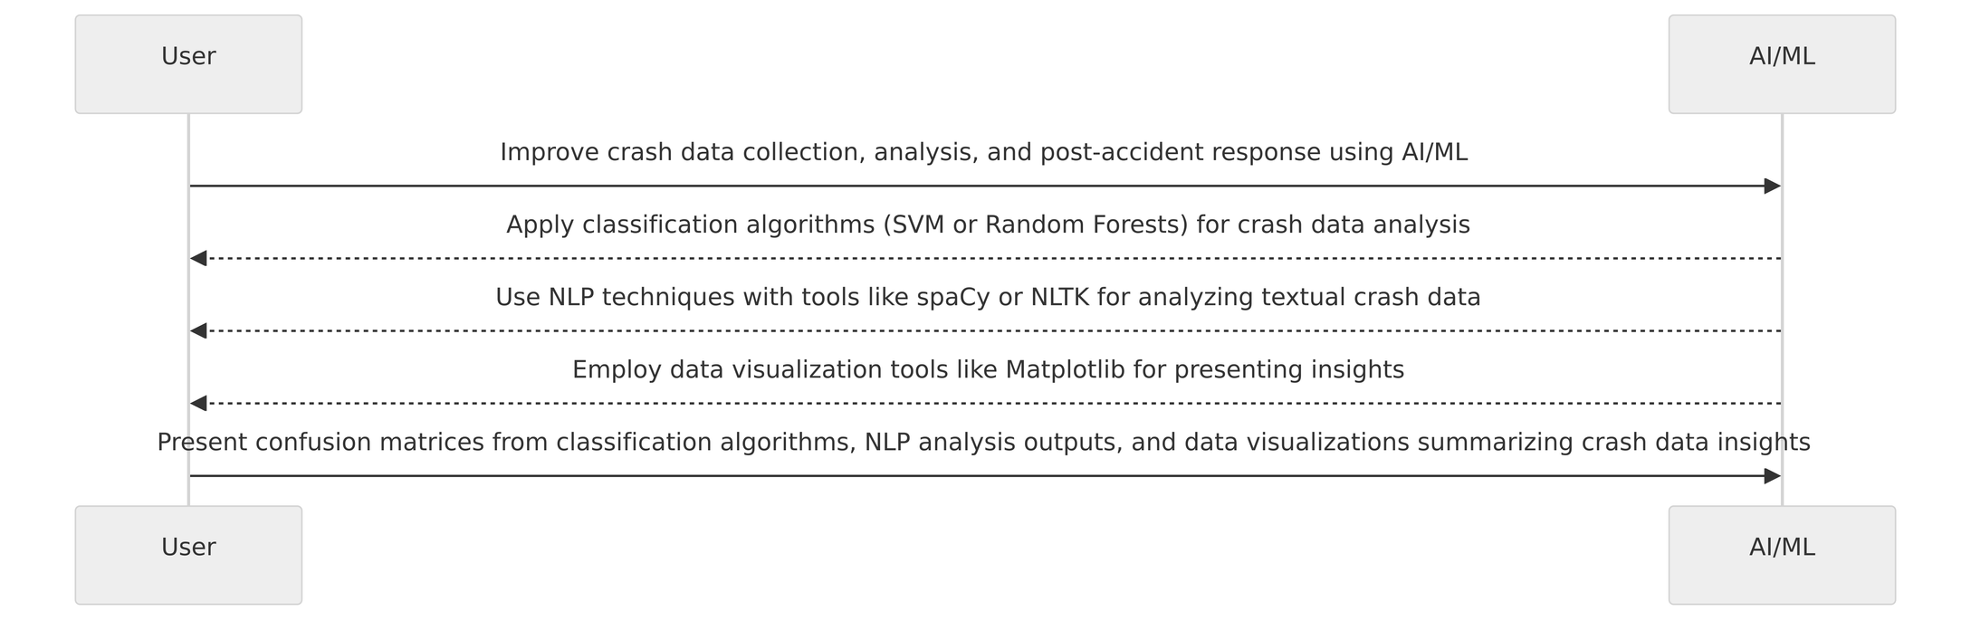
Crash Data Analysis
1. Data Input: The crash data analysis process begins with the input of detailed crash data, encompassing various information about the incidents, contributing factors, and involved parties.
2. Classification of Crash Types: Classification algorithms, such as Support Vector Machines (SVM) or Random Forests, are employed to categorize crash types based on the available data. This step aims to organize incidents into meaningful and distinguishable classes.
3. Textual Data Analysis: Natural Language Processing (NLP) techniques, implemented through tools like spaCy or NLTK, are utilized to analyze textual data associated with the crashes. This could include extracting insights from reports, witness statements, or other narrative descriptions.
4. Outcome Generation: The result of the analysis is an improved categorization of crash data, providing a clearer understanding of different incident types. Additionally, actionable insights are derived from the NLP analysis, contributing to a more comprehensive understanding of the factors contributing to each crash.
5. Visualization of Insights: Matplotlib is employed for visualizing the insights gained from crash data analysis. Graphs, charts, or other visual representations aid in presenting the patterns and trends identified, facilitating better decision-making and policy formulation.
6.Tools Utilized:
- Scikit-learn serves as a powerful tool for implementing classification algorithms, ensuring accurate and efficient categorization of crash data.
- spaCy or NLTK are used for natural language processing tasks, extracting valuable information from textual data associated with the crashes.
- Matplotlib is employed for creating visualizations that enhance the communication of findings, supporting data-driven decision-making in the context of road safety.

Slide 12

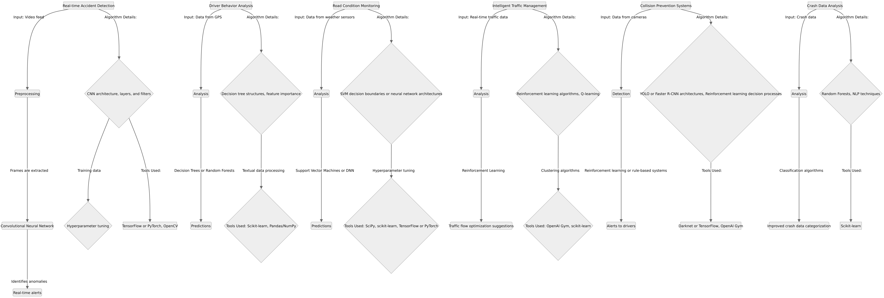
SYSTEM ARCHITECTURE

Slide 13
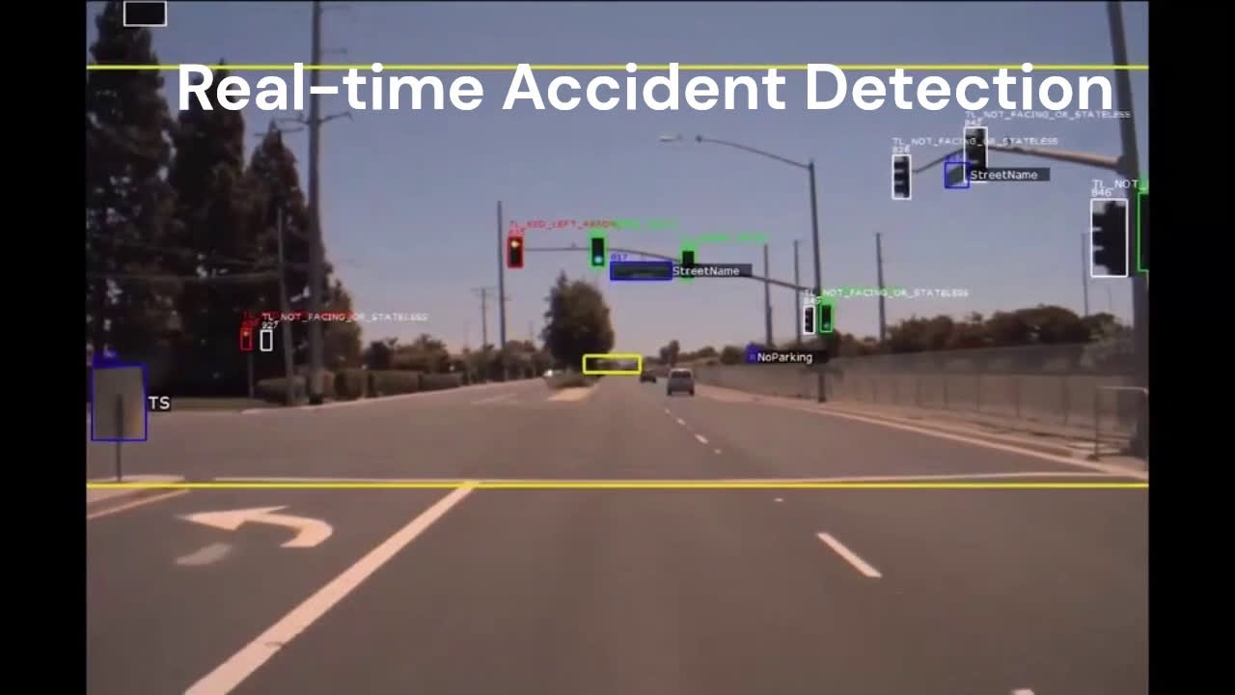

Slide 14


ThankYou
TEAM lrvijay2003
github link

